Slide 1
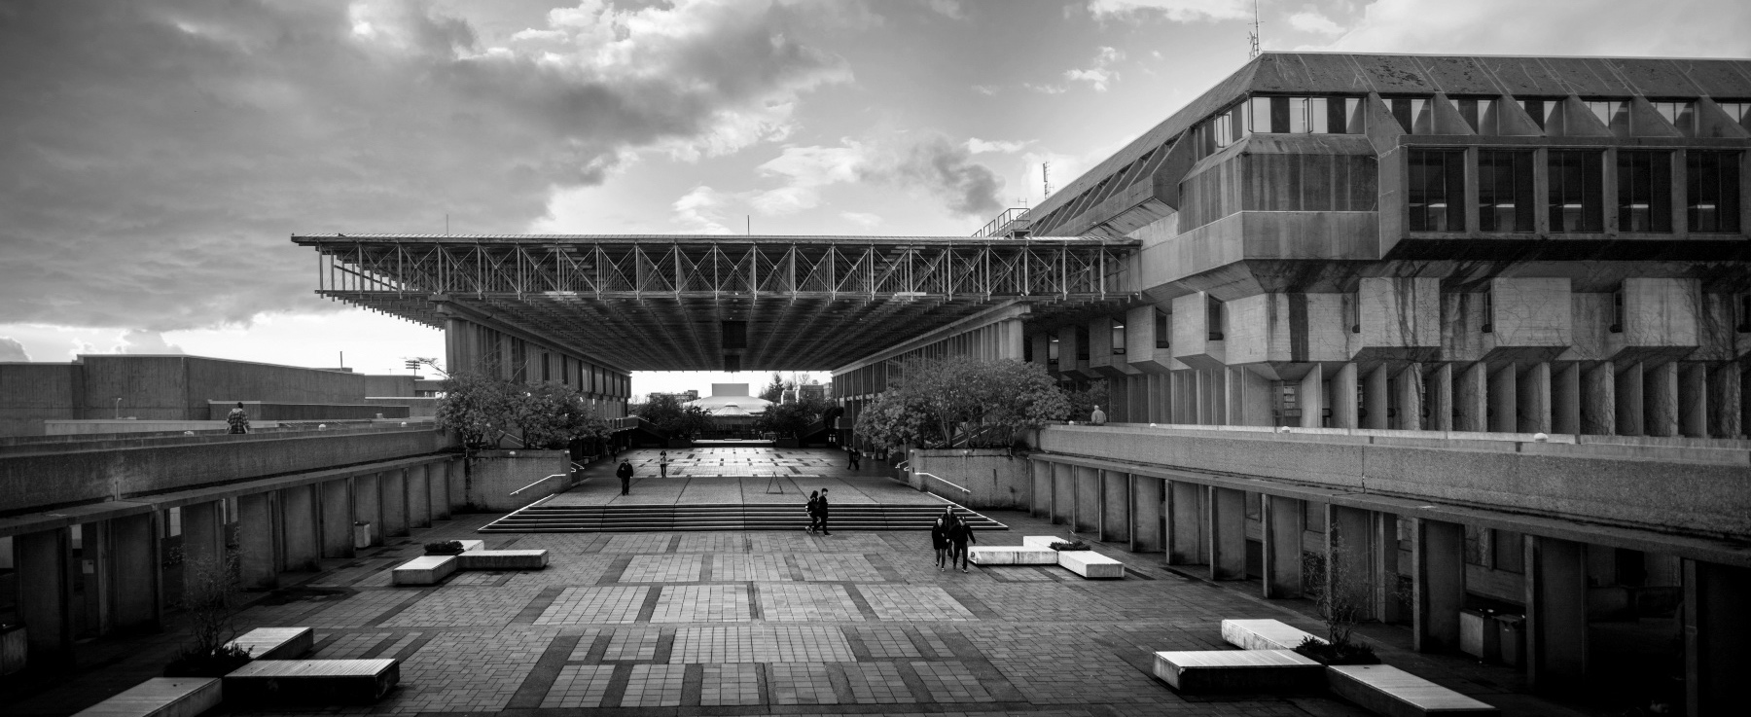

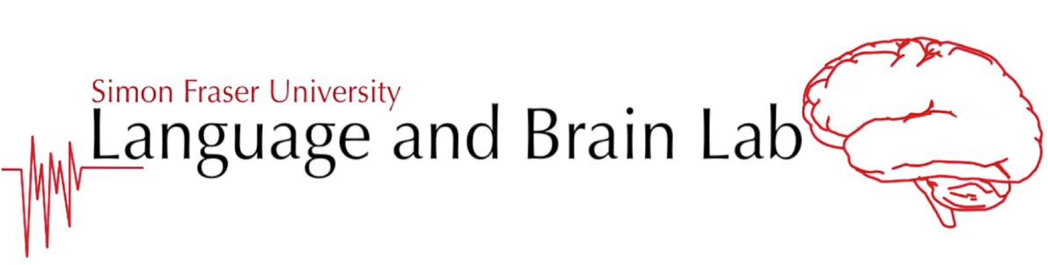
A novel collaborative task for eliciting phonetic adaptations in spontaneous conversational speech.
Notes:
I’ll be presenting on a collaborative computer game task using Jetic’s recording setup. I wrote an honours paper on it using the title “A novel collaborative task for eliciting phonetic adaptations in spontaneous conversational speech”.

Slide 2
Introduction
Proposing a novel interactive task
Goal of eliciting spontaneous conversational utterances
For investigating phonetic adaptation
Notes:
For the past year and a half in the lab, we’ve been working on proposing new interactive tasks, with the goal of eliciting spontaneous conversational utterances so that we could investigate phonetic adaptation.

Slide 3



Phonetic Adaptation
Phenomenon where speech production is non-consciously adjusted
For accommodating communication with an interlocutor^{1,2}
[1] Babel, 2009; [2] Lin et al., 2021
Notes:
Ivan will probably be going over this more, but phonetic adaptation is essentially when someone adjusts their speech production to facilitate communication with an interlocutor.

Slide 4
What is Phonetic Adaptation? a.k.a. phonetic/conversational accommodation, speech alignment, entrainment, convergence, resonance
Adjustment of pronunciation:
Non-conscious, spontaneous^{1,2,3}
For effective communication^{1,2,3}
Acoustic characteristics¹
speech rate
vowel intensity
vowel spectra
Influenced by social dynamics¹
[1] Dias & Rosenblum, 2016; [2] Lewandowski & Jilka, 2019; [3] Lin et al., 2021
Notes:
Sam:
A phenomenon with many names. It happens spontaneously for the purposes of effective communication. Phonetic adaptation manifests in acoustic characteristics and can be influenced by social dynamics.
Non-conscious, spontaneous phenomenon of adjusting one's pronunciation when verbally while interacting with an interlocutor in order to enhance communicative effectiveness
Manifests in acoustic characteristics
Social dynamics able to influence the degree of convergence

Slide 5
Interaction’s Desired Characteristics
Spontaneous speech > read speech
Power balance (Andreeva et al., 2021)
Elicit balanced amount of utterances
Control over conversation contents
Notes:
For this project, we’ve had some characteristics that we’ve been aiming to have in our new task. First, we wanted spontaneous speech instead of read speech. Second, we wanted there to be a balance of power between interlocutor dyads, because an imbalance can affect adaptation. Third, we wanted to elicit a balanced amount of utterances, to make for easier comparisons within a dyad. Fourth, we wanted to be able to control the conversation, to make for easier comparisons between dyads. I didn’t include it here, but we have also been keeping eye contact between interlocutors in mind.

Slide 6
Tasks in Past Literature
Scripted, non-collaborative
Shadowing; carrier phrase
Not spontaneous
Semi-scripted, non-collaborative
Interview; topic discussion; phone call
Struggles with control
Unscripted, quasi-collaborative
Sudoku; crossword
Collaboration not required
Unscripted, collaborative
Map task; Grid task; Diapix task
Notes:
In the past, other researchers have used a number of different speech elicitation tasks. There have been scripted non-collaborative tasks which use shadowing tasks or carrier phrases. These aren’t ideal because they don’t elicit spontaneous speech.
Semi-scripted non-collaborative tasks like interviews or phone calls are not ideal because they can struggle to control the contents of a conversation. Even if the topic can be controlled, the specific keywords that people use can’t be.
Unscripted, quasi-collaborative tasks like Sudoku and crossword puzzles have also been used, but they can be completed independently, without the participants conversing at all.
Unscripted, collaborative tasks are the closest to what our aim is in the lab, but still have some flaws.

Slide 7
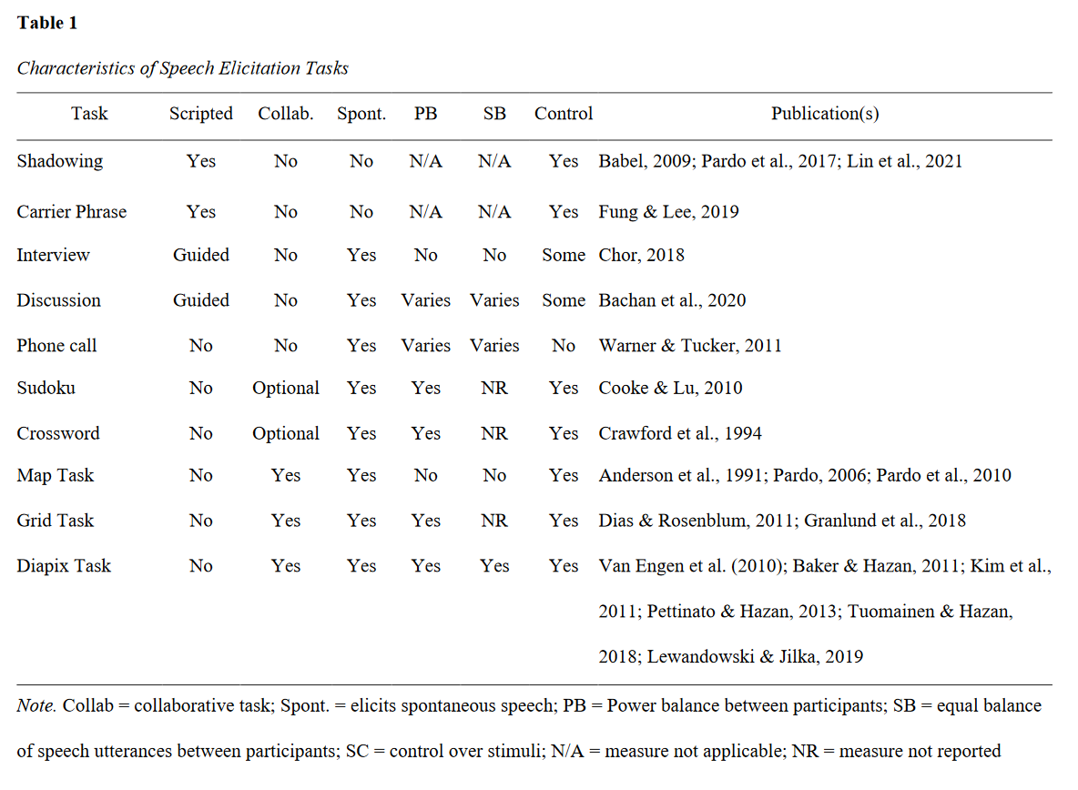
Notes:
Here is an overview of the tasks, each of their relevant characteristics (that could fit on the page), as well as the publications that they were used in.

Slide 8
Novel Task
Takes aspects of previous unscripted collaborative tasks
Place two participants in a video game (Pine Studio, 2021)
Present them with slightly differing sets of 32 pictures
Have them identify the 20 matching pairs
Notes:
The task Ivan and I have been working on takes aspects of the unscripted collaborative tasks. We’re using a video game called Escape Simulator, and spawning two participants in two separate rooms. In the rooms, they each see 32 pictures. The two rooms have 20 matching pairs, and then 12 images which are unique to each room. The participants are then asked to find those matching pairs and placed them in identical locations. They also see a blank screen every 2 minutes or so to try to get them to review what images they had just identified, and to get them to look away from the screen and at their partner/teammate.

Slide 9
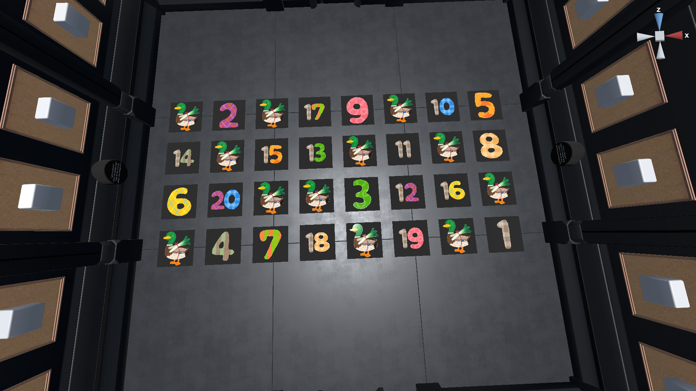
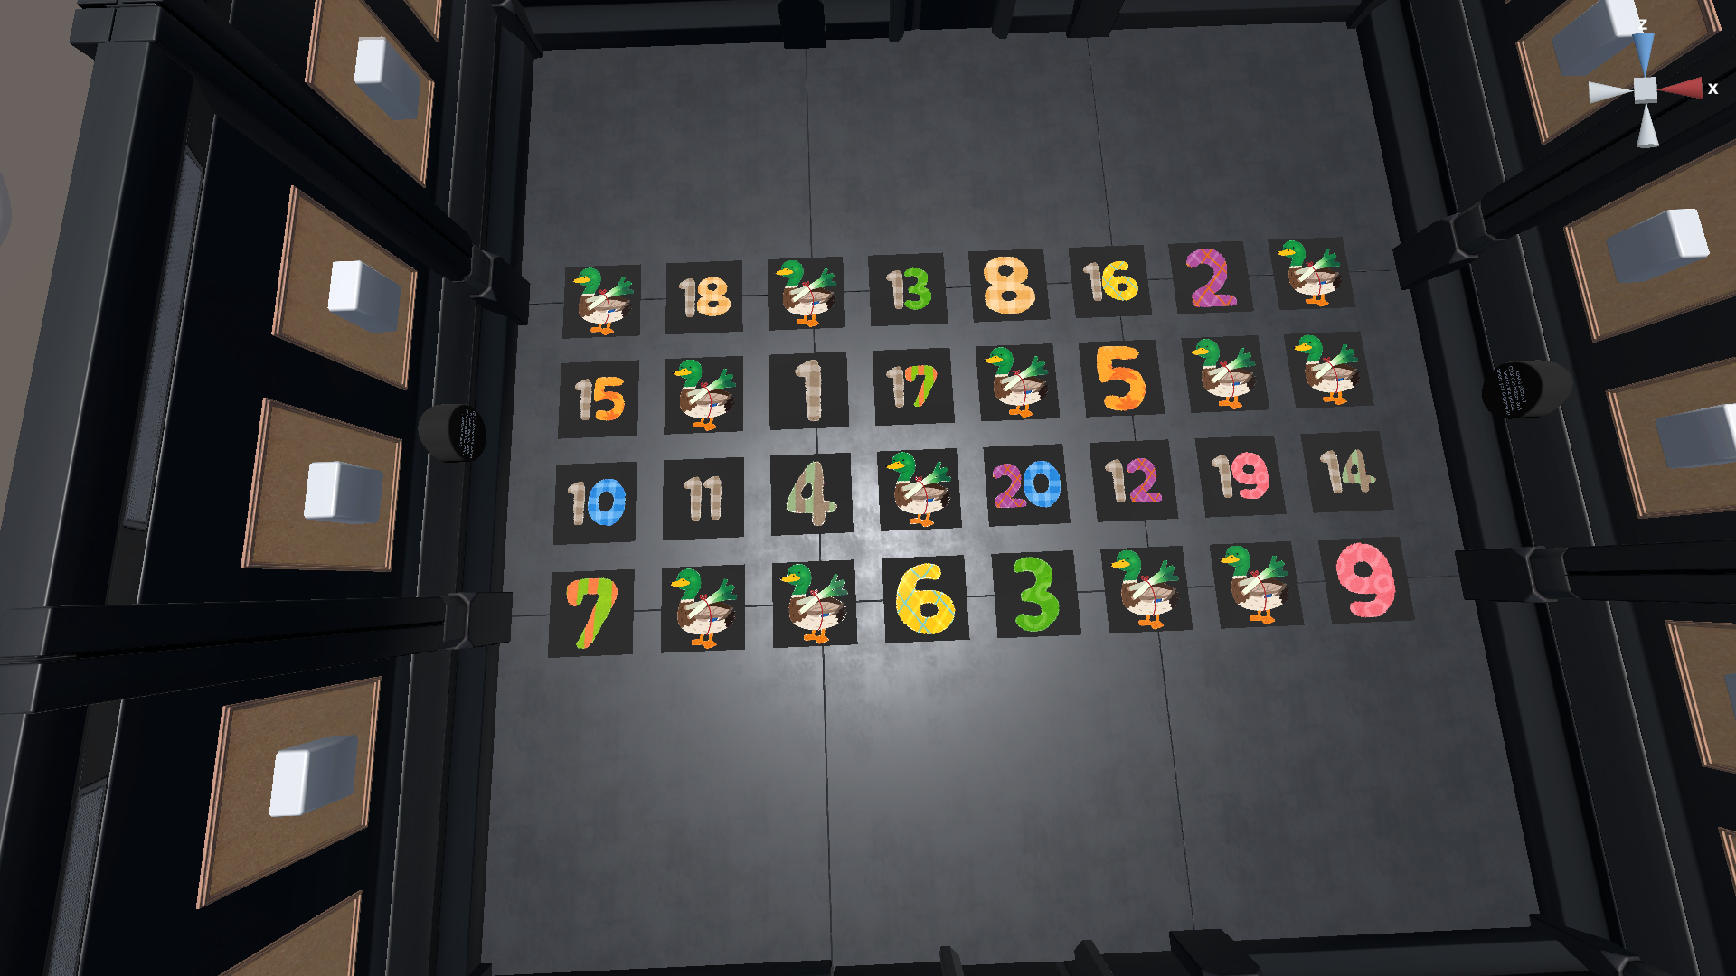
Notes:
Here is essentially the answer key. The participants would have to find the image with the number 1, and place that in the same location in each of their own rooms. There are also distractor images, which are the ducks, or decoys, which are the 12 unique images. When you’re running the experiment, you might make the distractor images a confusable word or a picture with a different background colour.

Slide 10
Methods: Recording Setup
Participants sat at opposite sides of a table
Two stand microphones placed on table
Participants control monitor behind their partner

Slide 11
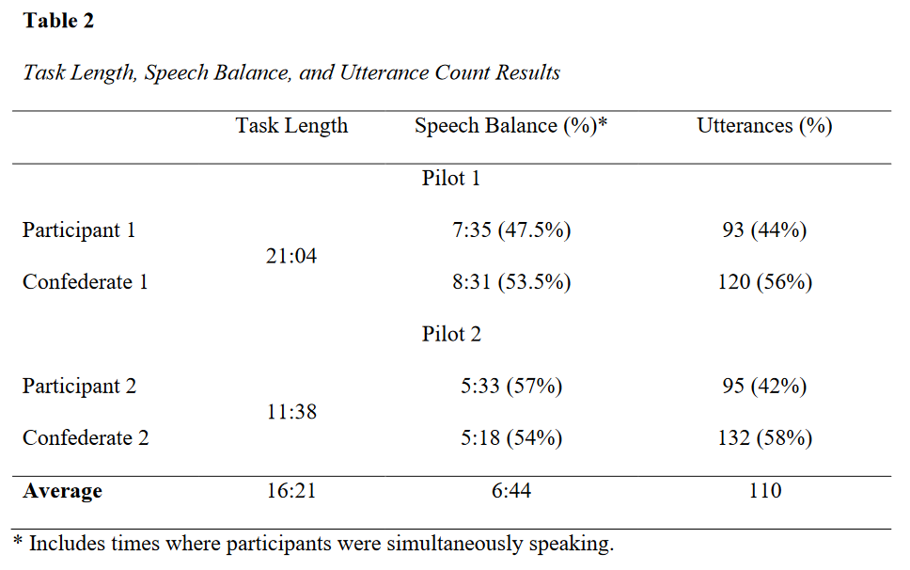
Results
Notes:
While the task seems pretty simple to do, it seemed capable of eliciting the speech that we were looking for. After two pilot runs with English stimuli, we got a task length of 16 minutes, somewhat balanced amounts of speech production and keyword utterances.
There were also variations in the amount of eye contact made by participants

Slide 12
Interaction’s Desired Characteristics
Spontaneous speech > read speech
Averaged 366.92s of spontaneous speech per speaker
Power balance
Confederates were not more knowledgeable than participants
Elicit balanced amount of utterances
Appears capable, but small sample size
Control over conversation contents
Participants’ memory limitations need to be considered
Notes:
Thinking back to our goals, we averaged 366 seconds of spontaneous speech per speaker. We had to use confederates, but were able to keep them from being more knowledgeable about the images than the participants were.
The task also appears capable of eliciting balanced amounts of keyword utterances. There was some difficulty in controlling the conversation contents because of participants memory limitations.

Slide 13
Future Iterations
Better in-game lighting, or improved monitors
Changes to blank screen
Improved instructions
Masked orthography
Make it clearer that the doors only open after all matches have been found
Notes:
In the future, there are some necessary changes that have already been identified. The display of the images needs to be improved, either in the game or physically with different monitors. Changes to the blank screen are also needed. Clearer instructions are needed as well, and will probably require adding even more text. Masked orthography has been suggested to help with participants’ memory of the keywords. We should also make it clearer when the task has ended, as confusion because of this resulted in some interruptions.

Slide 14
Future Explorations
use different languages
use different English stimuli
Use different populations
Non-native languages; hearing impaired participants
Without confederate participants
Measure of phonetic adaptation
Notes:
In the future, there should be explorations into using different languages, different English stimuli, and different populations. We should also try to run the task without confederate participants, and also look into phonetic adaptation measures.

Slide 15
Conclusions
Collaborative matching task done in a video game to elicit spontaneous speech
Small sample size, but seems promising
Notes:
We’ve proposed a new collaborative matching task done in a video game to elicit spontaneous speech. Despite a really small sample size, pilot results seem promising.

Slide 16
References
Anderson, A. H., Bader, M., Bard, E. G., Boyle, E., Doherty, G., Garrod, S., Isard, S., Kowtko, J., McAllister, J., Miller, J., Sotillo, C., Thompson, H. S., & Weinert, R. (1991). The Hcrc Map Task Corpus. Language and Speech, 34(4), 351–366. https://doi.org/10.1177/002383099103400404
Andreeva, B., Demenko, G., Bachan, J., Gessinger, I., Jankowska, K., Möbius, B. (2021). Phonetic convergence evaluation based on fundamental frequency variability. In S. Hillmann, B. Weiss, T. Michael, S. Möller (Eds.), Studientexte zur Sprachkommunikation Band 99: Elektronische Sprachsignalverarbeitung 2021 (pp. 153-160). TUDpress. https://www.essv.de/paper.php?id=1113
Bachan, J., Owsianny, M., & Demenko, G. (2020). The Harmonia Corpus – A dialogue corpus for automatic analysis of phonetic convergence. In Z. Vetulani, P. Paroubek, & M. Kubis (Eds.), Human Language Technology. Challenges for Computer Science and Linguistics (Vol. 12598, pp. 149–163). Springer International Publishing AG. https://doi.org/10.1007/978-3-030-66527-2_11
Baker, R. & Hazan, V. (2011). DiapixUK: Task materials for the elicitation of multiple spontaneous speech dialogs. Behavior Research Methods 43(3), 761-770. https://doi.org/10.3758/s13428-011-0075-y
Biro, T., Olmstead, A. J., & Viswanathan, N. (2022). Talker adjustment to perceived communication errors. Speech Communication, 138, 13–25. https://doi.org/10.1016/j.specom.2022.01.010
Bonino, A. Y., Leibold, L. J., & Buss, E. (2013). Release from perceptual masking for children and adults: Benefit of a carrier phrase. Ear and Hearing, 34(1), 3–14. https://doi.org/10.1097/AUD.0b013e31825e2841
Cooke, M., & Lu, Y. (2010). Spectral and temporal changes to speech produced in the presence of energetic and informational maskers. The Journal of the Acoustical Society of America, 128(4), 2059–2069. https://doi.org/10.1121/1.3478775
Dias, J. W., & Rosenblum, L. D. (2011). Visual influences on interactive speech alignment. Perception (London), 40(12), 1457–1466. https://doi.org/10.1068/p7071
Fong, I., To, S., Wang, Y. (2023, February 17). Reversing a Cantonese tone-merger through conversation tasks [Presentation]. 7th Annual Language Sciences Undergraduate Research Conference (LSURC), University of British Columbia, Vancouver, British Columbia, Canada. https://1sfu-my.sharepoint.com/:p:/g/personal/ifa8_sfu_ca/EUROg-k1NbNEnBEWvoiUQpsB6Z3RWSKnlyjAgHgLM6MFaQ
Granlund, S., Hazan, V., & Mahon, M. (2018). Children's acoustic and linguistic adaptations to peers with hearing impairment. Journal of Speech, Language, and Hearing Research, 61(5), 1055–1069. https://doi.org/10.1044/2017_JSLHR-S-16-0456
Hazan, V., & Baker, R. (2011). Acoustic-phonetic characteristics of speech produced with communicative intent to counter adverse listening conditions. The Journal of the Acoustical Society of America, 130(4), 2139–2152. https://doi.org/10.1121/1.3623753
Kim, M., Horton, W. S., & Bradlow, A. R. (2011). Phonetic convergence in spontaneous conversations as a function of interlocutor language distance. Laboratory Phonology, 2(1). https://doi.org/10.1515/labphon.2011.004
Laan, G. P. M., & van Bergem, D. R. (1993) The contribution of pitch contour, phoneme durations and spectral features to the character of spontaneous and read aloud speech. Proc. 3rd European Conference on Speech Communication and Technology (Eurospeech 1993), 569-572, doi: 10.21437/Eurospeech.1993-134
Lewandowski, N. & Jilka, M. (2019). Phonetic convergence, language talent, personality and attention. Frontiers in Communication, 4(18). https://doi.org/10.3389/fcomm.2019.00018
Lin, Y., Yao, Y., & Luo, J. (2021). Phonetic accommodation of tone: Reversing a tone merger-in-progress via imitation. Journal of Phonetics, 87, 101060. https://doi.org/10.1016/j.wocn.2021.101060
Pardo, J. S. (2006). On phonetic convergence during conversational interaction. The Journal of the Acoustical Society of America, 119(4), 2382–2393. https://doi.org/10.1121/1.2178720
Pardo, J. S., Jay, I. C., & Krauss, R. M. (2010). Conversational role influences speech imitation. Attention, Perception & Psychophysics, 72(8), 2254–2264. https://doi.org/10.3758/BF03196699
Pardo, J. S., Urmanche, A., Wilman, S., & Wiener, J. (2017). Phonetic convergence across multiple measures and model talkers. Attention, Perception & Psychophysics, 79(2), 637–659. https://doi.org/10.3758/s13414-016-1226-0
Pettinato, M., & Hazan, V. (2013). The development of clear speech strategies in 9–14 year olds. The Journal of the Acoustical Society of America, 133(5), 3390–3390. https://doi.org/10.1121/1.4805870
Pine Studio. (2021). Escape Simulator (Version 1.0.24338r) [Video Game]. Samobor, Croatia. https://pinestudio.com/games/escape-simulator/
Scarborough, R., & Zellou, G. (2013). Clarity in communication: "clear" speech authenticity and lexical neighborhood density effects in speech production and perception. The Journal of the Acoustical Society of America, 134(5), 3793–3807. https://doi.org/10.1121/1.4824120
Tuomainen, O. & Hazan, V. (2018). Investigating clear speech adaptations in spontaneous speech produced in communicative settings. In M. Gósy & T.E. Gráczi (Eds.), Challenges in analysis and processing of spontaneous speech (pp. 9-25). https://doi.org/10.18135/CAPSS.9
Van Engen, K. J., Baese-Berk, M., Baker, R. E., Choi, A., Kim, M., & Bradlow, A. R. (2010). The Wildcat Corpus of native-and foreign-accented English: Communicative efficiency across conversational dyads with varying language alignment profiles. Language and Speech, 53(4), 510–540. https://doi.org/10.1177/0023830910372495
Warner, N., & Tucker, B. V. (2011). Phonetic variability of stops and flaps in spontaneous and careful speech. The Journal of the Acoustical Society of America, 130(3), 1606–1617. https://doi.org/10.1121/1.3621306
Wilson, R. H., & Sanchez, V. A. (2020). Effects of the carrier phrase on word recognition performances by younger and older listeners using two stimulus paradigms. Journal of the American Academy of Audiology, 31(6), 412–441. https://doi.org/10.3766/jaaa.19061

Slide 17
References
Laan, G. P. M., & van Bergem, D. R. (1993) The contribution of pitch contour, phoneme durations and spectral features to the character of spontaneous and read aloud speech. Proc. 3rd European Conference on Speech Communication and Technology (Eurospeech 1993), 569-572, doi: 10.21437/Eurospeech.1993-134
Lewandowski, N. & Jilka, M. (2019). Phonetic convergence, language talent, personality and attention. Frontiers in Communication, 4(18). https://doi.org/10.3389/fcomm.2019.00018
Lin, Y., Yao, Y., & Luo, J. (2021). Phonetic accommodation of tone: Reversing a tone merger-in-progress via imitation. Journal of Phonetics, 87, 101060. https://doi.org/10.1016/j.wocn.2021.101060
Pardo, J. S. (2006). On phonetic convergence during conversational interaction. The Journal of the Acoustical Society of America, 119(4), 2382–2393. https://doi.org/10.1121/1.2178720
Pardo, J. S., Jay, I. C., & Krauss, R. M. (2010). Conversational role influences speech imitation. Attention, Perception & Psychophysics, 72(8), 2254–2264. https://doi.org/10.3758/BF03196699
Pardo, J. S., Urmanche, A., Wilman, S., & Wiener, J. (2017). Phonetic convergence across multiple measures and model talkers. Attention, Perception & Psychophysics, 79(2), 637–659. https://doi.org/10.3758/s13414-016-1226-0
Pettinato, M., & Hazan, V. (2013). The development of clear speech strategies in 9–14 year olds. The Journal of the Acoustical Society of America, 133(5), 3390–3390. https://doi.org/10.1121/1.4805870
Pine Studio. (2021). Escape Simulator (Version 1.0.24338r) [Video Game]. Samobor, Croatia. https://pinestudio.com/games/escape-simulator/
Scarborough, R., & Zellou, G. (2013). Clarity in communication: "clear" speech authenticity and lexical neighborhood density effects in speech production and perception. The Journal of the Acoustical Society of America, 134(5), 3793–3807. https://doi.org/10.1121/1.4824120
Tuomainen, O. & Hazan, V. (2018). Investigating clear speech adaptations in spontaneous speech produced in communicative settings. In M. Gósy & T.E. Gráczi (Eds.), Challenges in analysis and processing of spontaneous speech (pp. 9-25). https://doi.org/10.18135/CAPSS.9
Van Engen, K. J., Baese-Berk, M., Baker, R. E., Choi, A., Kim, M., & Bradlow, A. R. (2010). The Wildcat Corpus of native-and foreign-accented English: Communicative efficiency across conversational dyads with varying language alignment profiles. Language and Speech, 53(4), 510–540. https://doi.org/10.1177/0023830910372495
Warner, N., & Tucker, B. V. (2011). Phonetic variability of stops and flaps in spontaneous and careful speech. The Journal of the Acoustical Society of America, 130(3), 1606–1617. https://doi.org/10.1121/1.3621306
Wilson, R. H., & Sanchez, V. A. (2020). Effects of the carrier phrase on word recognition performances by younger and older listeners using two stimulus paradigms. Journal of the American Academy of Audiology, 31(6), 412–441. https://doi.org/10.3766/jaaa.19061

